Slide 1
Design and Analysis of Algorithms CS345
Lecture 6
Augmented BST (Final lecture)
Interval tree:
an augmented BST used for geometric problems

Slide 2
Dynamic Sequence
A sequence: $e_{1}$, $e_{2}$,…, $e_{n}$.
Aim :
maintain a data structure D for the sequence under the following operations.
Basic Operations:
Insert(D,$i$,$x$): Insert element $x$ at $i$th place in the sequence.
Delete(D,$i$): Delete $i$th element from the sequence.
Report(D,$i$): Report $i$th element from the sequence
Application specific operation:
Min(D,$i$,$j$): report minimum element from $e_{i}$,…,$e_{j}$.
Add(D,$i$,$j$,$x$): Add $x$to all elements from $e_{i}$,…,$e_{j}$.
Flip(D,$i$,$j$): Flip all bits $e_{i}$,…,$e_{j}$.
OR
OR

Slide 3
Representing sequence using a BST
A sequence: $e_{1}$, $e_{2}$,…, $e_{n}$.
Example: $6$, $0$, $5$, $13$, $2$, $14$, $1$, $32$.
“Inorder traversal produces the sequence.”
How can we represent a sequence using BST ?
$$2$$
$$0$$
$$1$$
$$6$$
$$5$$
$$14$$
$$32$$
$$13$$

Slide 4



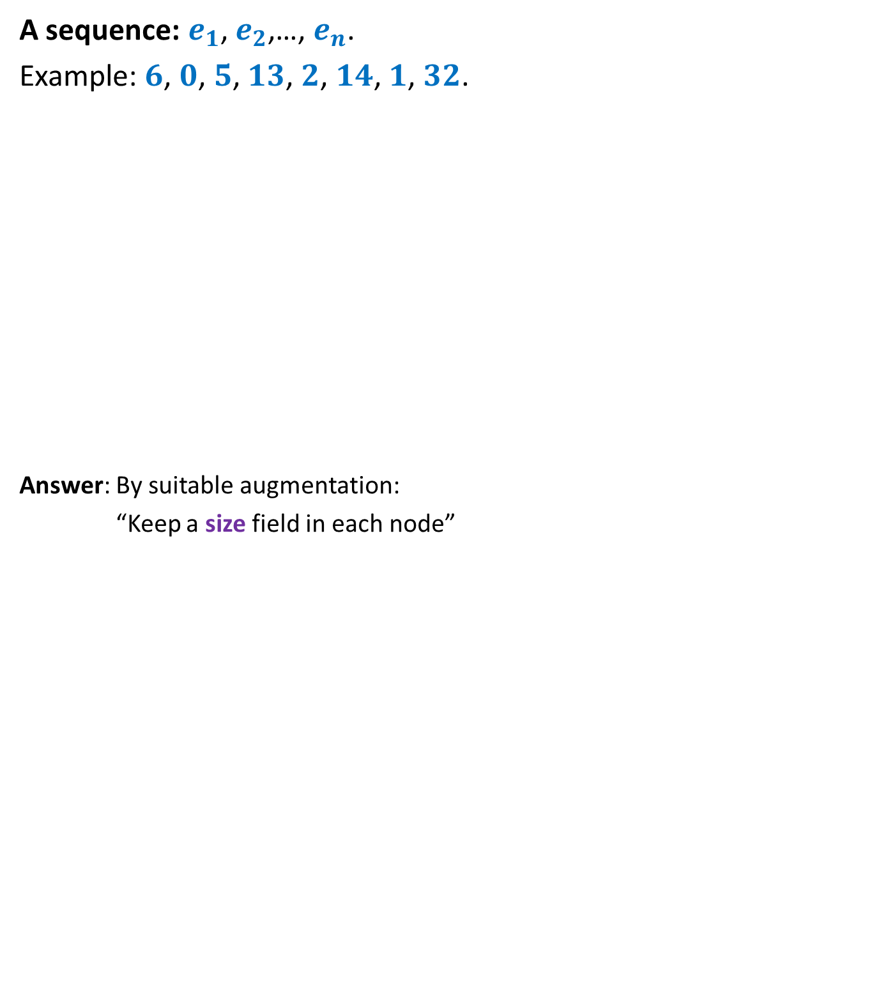

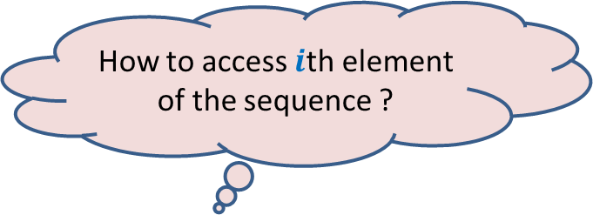




Representing sequence using a BST
A sequence: $e_{1}$, $e_{2}$,…, $e_{n}$.
Example: $6$, $0$, $5$, $13$, $2$, $14$, $1$, $32$.
Answer: By suitable augmentation:
“Keep a size field in each node”
How to access $i$th element of the sequence ?
: size field
$$2$$
8
$$0$$
4
$$1$$
3
$$6$$
1
$$5$$
2
$$14$$
1
$$32$$
1
$$13$$
1

Slide 5





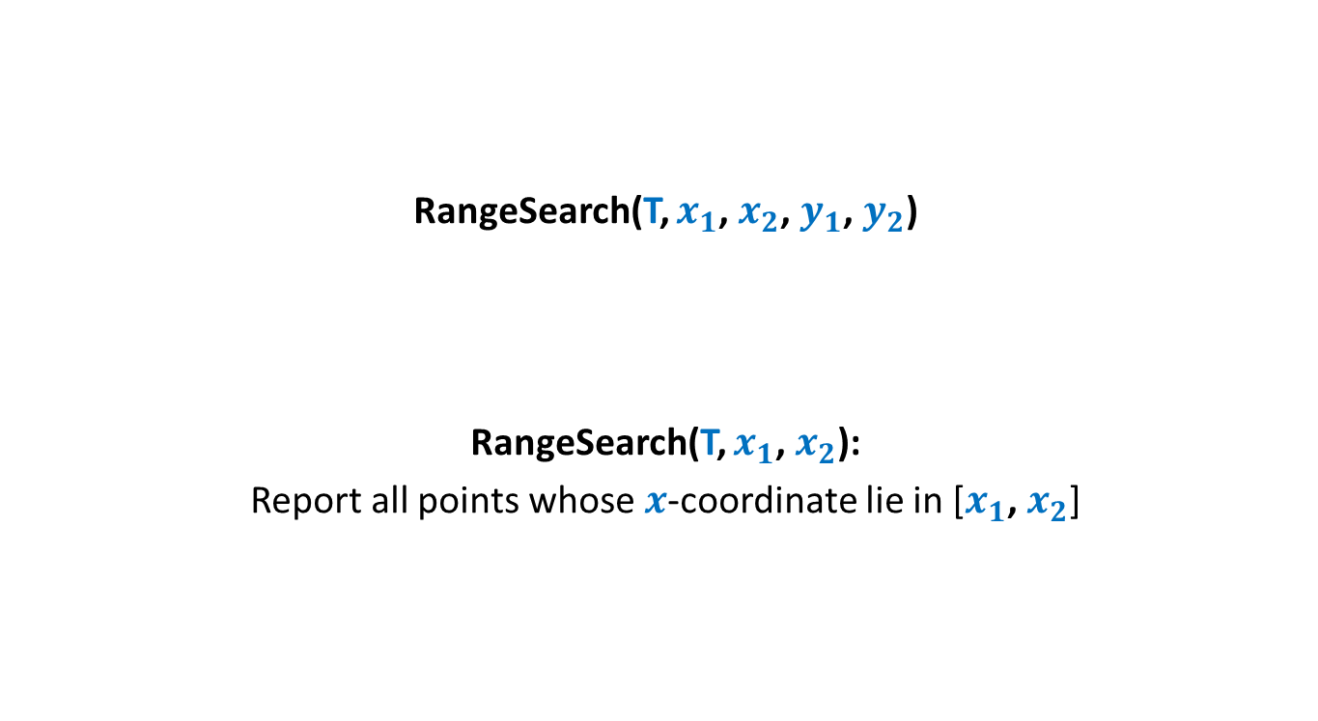
Report($T,$ $i$)
Report(T,$i$)
{ found=false; $\text{u} \text{← }$T ;
While( not found)
{
s ← size(left(u));
if(s = $i−1$) ?? ;
else if(s > $i−1$) ?? ;
else {
?? ;
?? ;
}
}
return val(u);
}
u
if(left(u)=NULL) s ← 0;
else
$\text{found}\text{← }\text{true}$;
$$\text{u} \text{← }\text{left}\text{(}\text{u}\text{)}$$
$i\text{←}i−$size(left(u)) $−$1
u← $\text{right}\text{(}\text{u}\text{)}$;

Slide 6
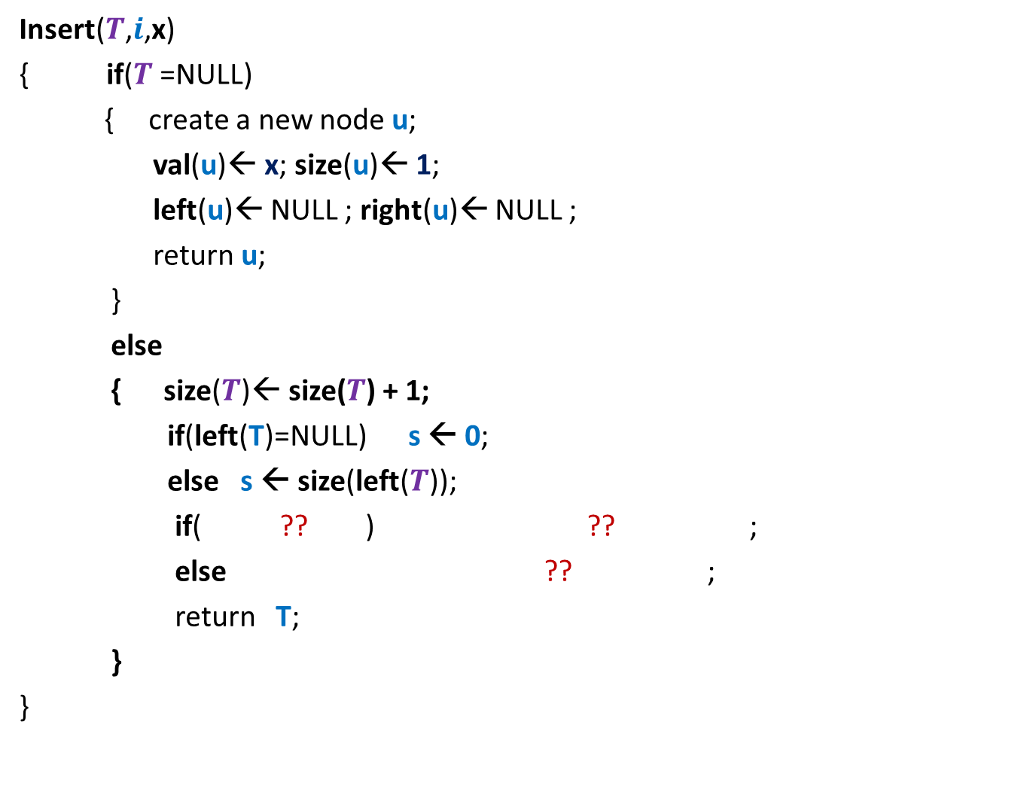




Insert($T,$ $i$, x)
Insert($T$,$i$,x)
{ if($T$=NULL)
{ create a new node $\text{u}$;
val($\text{u}$)← x; size($\text{u}$)← 1;
left($\text{u}$)← NULL ; right($\text{u}$)← NULL ;
return $\text{u}$;
}
else
{ size($T$)← size($T$) + 1;
if(left(T)=NULL) s ← 0;
else s ← size(left($T$));
if( ?? ) ?? ;
else ?? ;
return $\text{T}$;
}
}
T
Don’t forget to rebalance the tree height at the end !
$i$ $≤$s $+$1
$$\text{left}\text{(}T\text{)} \text{←}\text{Insert}\text{(}\text{(}\text{left}\text{(}T\text{))}\text{,}i\text{,}\text{x}\text{)}$$
$\text{righ}\text{t}\text{(}T\text{)} \text{←}\text{Insert}\text{(}\text{(}\text{right}\text{(}T\text{))}\text{,}i−s−\text{1}\text{,}\text{x}\text{)}$;

Slide 7
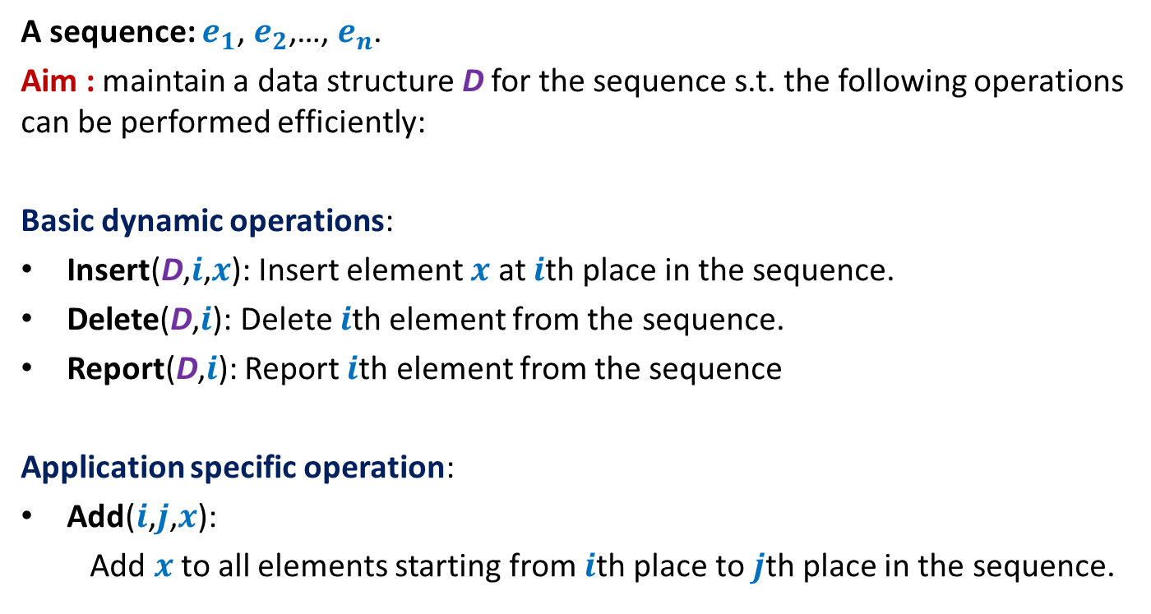
Example 2: sequence of numbers
A sequence: $e_{1}$, $e_{2}$,…, $e_{n}$.
Aim : maintain a data structure D for the sequence s.t. the following operations can be performed efficiently:
Basic dynamic operations:
Insert(D,$i$,$x$): Insert element $x$ at $i$th place in the sequence.
Delete(D,$i$): Delete $i$th element from the sequence.
Report(D,$i$): Report $i$th element from the sequence
Application specific operation:
Add($i$,$j$,$x$):
Add $x$to all elements starting from $i$th place to $j$th place in the sequence.

Slide 8
Performing Add(T,i,j,x)
View the entire tree T from perspective of the paths from i and j to the root.
How will T look like ?
LCA(i,j)
j
i
T

Slide 9
Performing Add(T,i,j,x)
What are the nodes whose values has to be incremented by x ?
LCA(i,j)
j
i
T

Slide 10
Performing Add(T,i,j,x)
LCA(i,j)
j
i
T

Slide 11

Performing Add(T,i,j,x)
Easy
There are O(log $n$) nodes on the two paths whose value needs to incremented.
There are O(log $n$) subtrees also s.t. value of each of their elements needs to incremented☹
We can not afford to increment the value of each node in these subtrees explicitly. So what to do ?
: incr
LCA(i,j)
Keep an extra field incr
such that adding x to incr field of v means
….
j
adding x to each element in T(v)
i
T

Slide 12


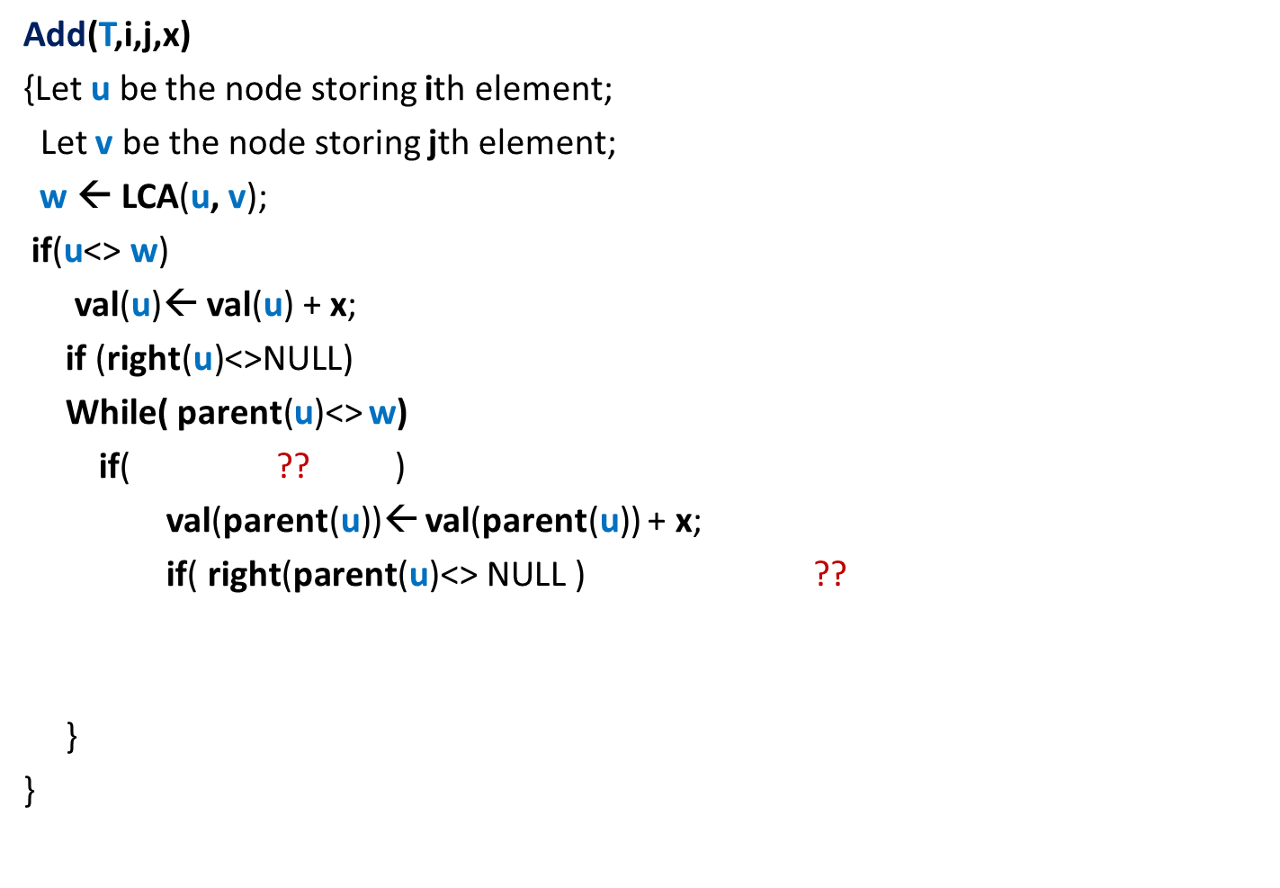



Performing Add(T,i,j,x)
Add(T,i,j,x)
{Let $\text{u}$ be the node storing ith element;
Let $\text{v}$ be the node storing jth element;
$\text{w} \text{← }$LCA($\text{u}$, $\text{v}$);
if($\text{u}$<> $\text{w}$)
val($\text{u}$)← val($\text{u}$) + x;
if (right(u)<>NULL)
While( parent($\text{u}$)<> $\text{w}$)
if( ?? )
val(parent($\text{u}$))← val(parent($\text{u}$)) + x;
if( $\text{right}\text{(}\text{parent}\text{(}\text{u}\text{)<> }\text{NULL}\text{ )}$ ??
}
}
val($\text{w}$)← val($\text{w}$) + x
{
incr(right($\text{u}$))← incr(right($\text{u}$)) + x ;
{
$\text{u}$=left(parent(u))
{
Incr(right($\text{parent}\text{(}\text{u}$)))← incr(right($\text{parent}\text{(}\text{u}$))) + x;
}
$\text{u}\text{←}\text{parent}\text{(}\text{u}$);
------- similarly process $\text{v}$---------(do it as homework);

Slide 13
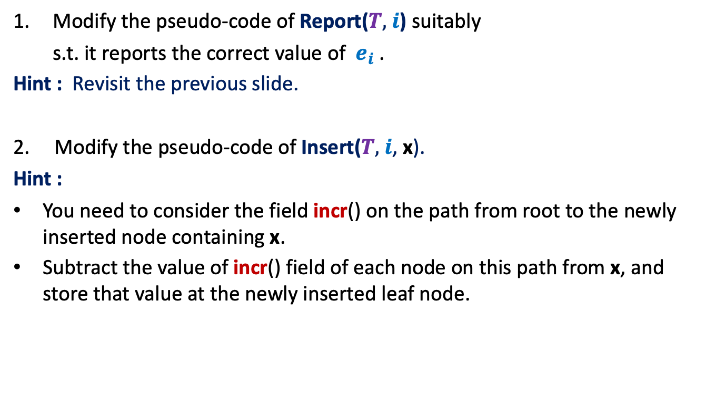
Homework
Modify the pseudo-code of Report($T,$ $i$) suitably
s.t. it reports the correct value of $e_{i}$ .
Hint : Revisit the previous slide.
2. Modify the pseudo-code of Insert($T,$ $i$, x).
Hint :
You need to consider the field incr() on the path from root to the newly inserted node containing x.
Subtract the value of incr() field of each node on this path from x, and store that value at the newly inserted leaf node.

Slide 14
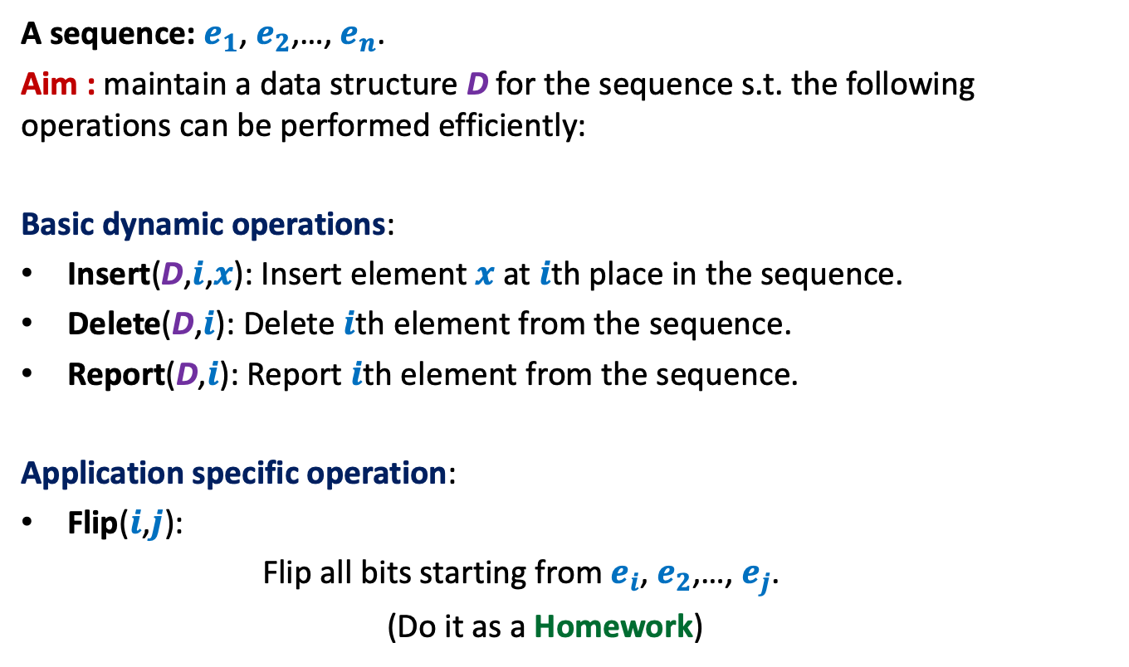
Example 3: sequence of bits
A sequence: $e_{1}$, $e_{2}$,…, $e_{n}$.
Aim : maintain a data structure D for the sequence s.t. the following operations can be performed efficiently:
Basic dynamic operations:
Insert(D,$i$,$x$): Insert element $x$ at $i$th place in the sequence.
Delete(D,$i$): Delete $i$th element from the sequence.
Report(D,$i$): Report $i$th element from the sequence.
Application specific operation:
Flip($i$,$j$):
Flip all bits starting from $e_{i}$, $e_{2}$,…, $e_{j}$.
(Do it as a Homework)

Slide 15
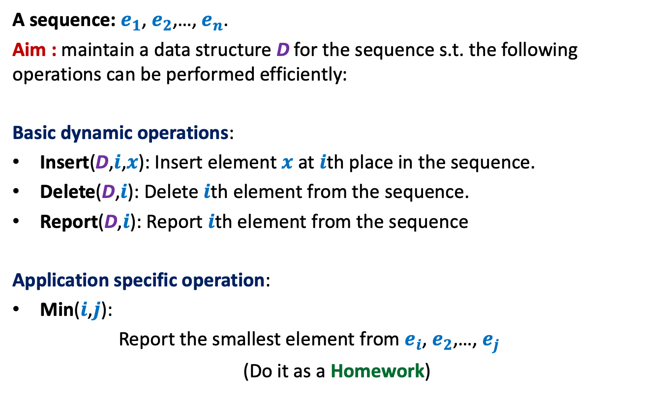
Example 1: sequence of numbers
A sequence: $e_{1}$, $e_{2}$,…, $e_{n}$.
Aim : maintain a data structure D for the sequence s.t. the following operations can be performed efficiently:
Basic dynamic operations:
Insert(D,$i$,$x$): Insert element $x$ at $i$th place in the sequence.
Delete(D,$i$): Delete $i$th element from the sequence.
Report(D,$i$): Report $i$th element from the sequence
Application specific operation:
Min($i$,$j$):
Report the smallest element from $e_{i}$, $e_{2}$,…, $e_{j}$
(Do it as a Homework)

Slide 16
interval tree
An augmented BST used for many
geometric problems

Slide 17





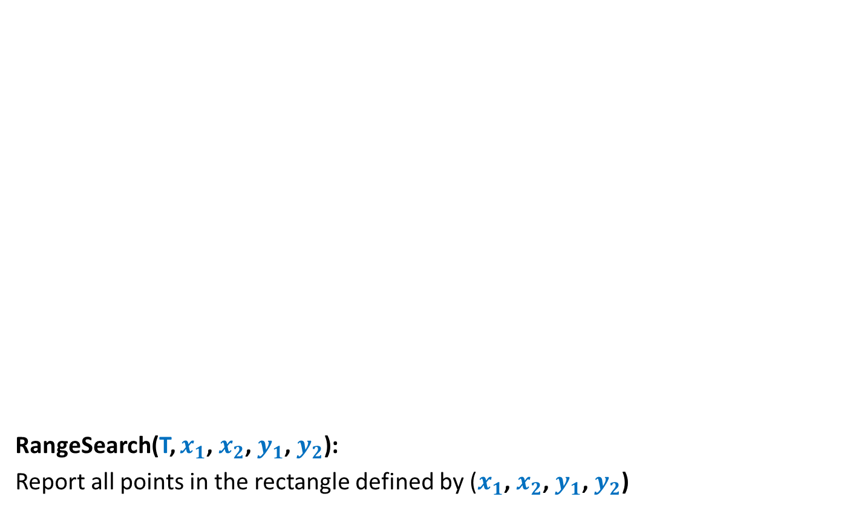
Interval
An interval [$a$, $b$] = {$x∈R$| $a≤x≤b$}.
For an interval $I$ = [$a$, $b$],
high[$I$] = $b$
low[$I$] = $a$
Given any two intervals [$a$, $b$] and [$c$, $d$],
they either overlap or don’t overlap.
➔ It takes O(1) time to check if two intervals overlap.
$$a$$
$$b$$
$$c$$
$$d$$
$$c$$
$$d$$
$$c$$
$$d$$
$$c$$
$$d$$

Slide 18
Problem Definition
Maintain a data structure for a set $S$ of intervals
so that the following operations can be performed efficiently.
Insert($S$,$I$): Insert interval $I$into $S$.
Delete($S$,$I$): Delete $I$from $S$.
Overlap($S$,$I$): determine if $I$overlaps any interval from $S$.
$$I$$
$$I$$
1
3
10
19
23
27
4
20
7
11
24
30

Slide 19
How to build a BST on intervals ?
1
3
10
19
23
27
4
20
7
11
24
30

Slide 20
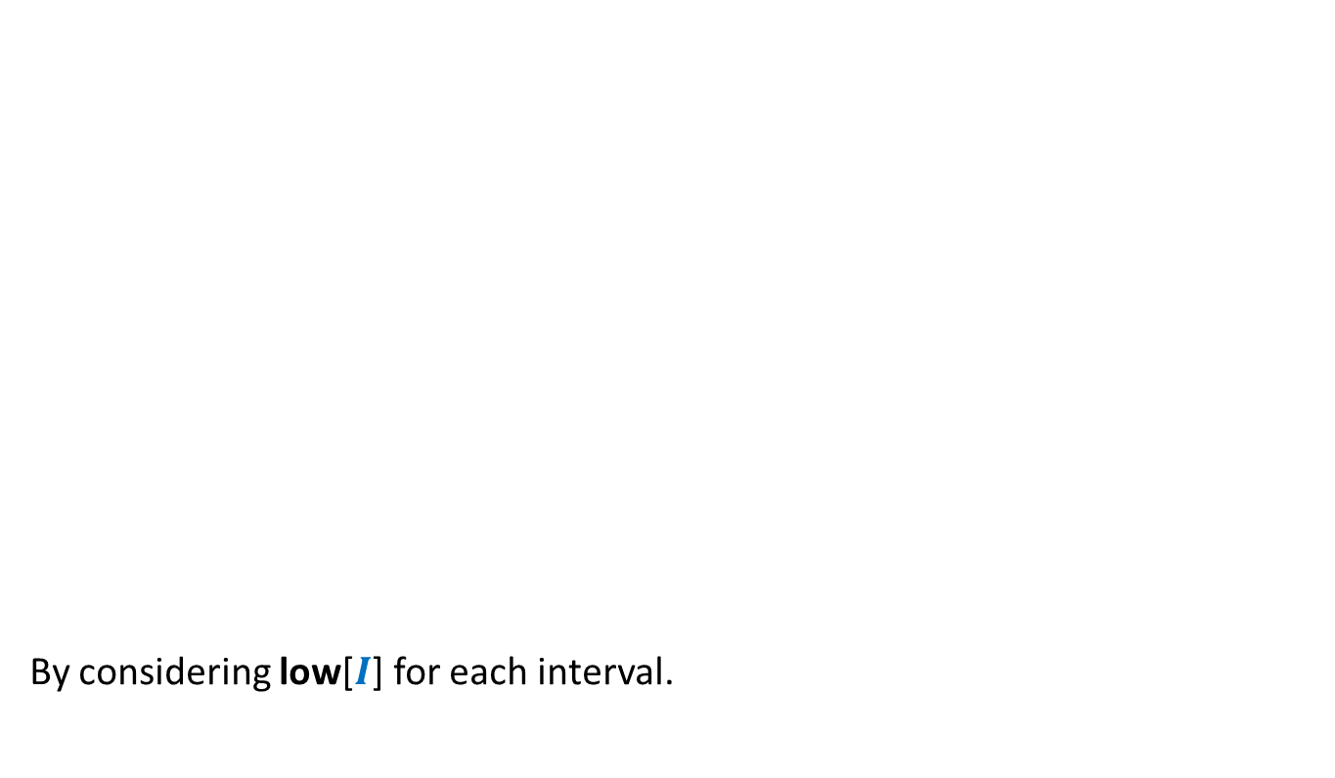
How to build a BST on intervals ?
How to define a total order on intervals ?
By considering low[$I$] for each interval.
1
3
10
19
23
27
4
20
7
11
24
30

Slide 21
How to build a BST on intervals ?
1
3
10
19
23
27
4
20
7
11
24
30

Slide 22

How to augment the BST ?
?
Main objective: How to perform Overlap($S$,$I$) efficiently ?
“determine if a query interval $I$overlaps any interval in tree storing intervals $S$.”
?
?
?
?
?

Slide 23


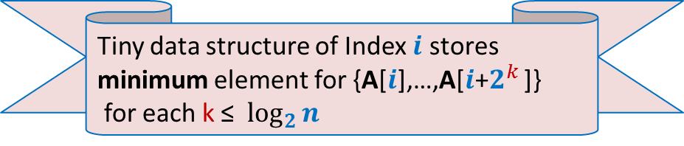


How to perform Overlap($S$,$I$) efficiently ?
$$c$$
$$d$$
$$c$$
$$d$$
$$c$$
$$d$$
$$a$$
$$b$$
$$L$$
$$R$$

Slide 24

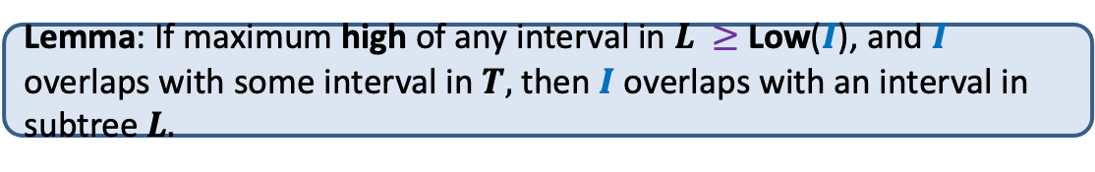
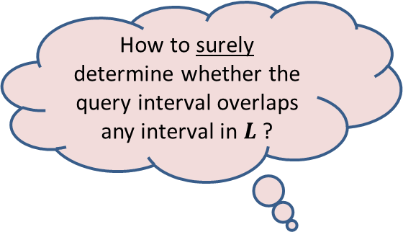


How to perform Overlap($S$,$I$) efficiently ?
$$a$$
$$b$$
How to surely determine whether the query interval overlaps any interval in $L$?
$$T$$
$$L$$
$$R$$
Exercise: Prove the Lemma
By knowing the maximum high of any interval in $L$ ?
Lemma: If maximum high of any interval in $L$ $≥$ Low($I$), and $I$ overlaps with some interval in $T,$ then $I$ overlaps with an interval in subtree $L.$

Slide 25

Augmentation of BST
10
30
19
For each node $\text{u}$, keep a field Max-high($\text{u}$):
Max-high($\text{u}$) = max{ high($I$) : $I∈$ T($\text{u}$)}
= max( ? , ? , ? )
4
20
23
27
20
30
1
3
7
11
24
30
3
11
30
This field is efficient to maintain during insertion/deletion
Max-high(left($\text{u}$))
high($\text{u}$)
Max-high(right($\text{u}$))

Slide 26



Overlap($T,$ $I$)
$$c$$
$$c$$
$$c$$
$$d$$
$$d$$
$$d$$
Overlap(T,$I$)
{ found=false;
While( ?? )
if($I$overlaps Interval(u))
$\text{found}\text{← }\text{true}$;
else
{ If( ? and ? )
u← $\text{lef}\text{t}\text{(}\text{u}\text{)}$;
else u← $\text{right}\text{(}\text{u}\text{)}$;
}
}
If(found) print “Interval(u) overlaps $I$”;
else print “No interval overlaps $I$”.
}
$\text{u} \text{← }$T ;
$\text{u}$<>NULL and not found
$$a$$
u
$$b$$
{
$\text{left}\text{(}\text{u}\text{)}$<> NULL
Max-high(left(u)) $>$Low($I$)
O(log $n$) time

Slide 27

Application 1
Given a set of $n$axis-parallel rectangles,
determine if any two of them intersect.

Slide 28
Application 1
Given a set of $n$axis-parallel rectangles,
determine if any two of them intersect.

Slide 29

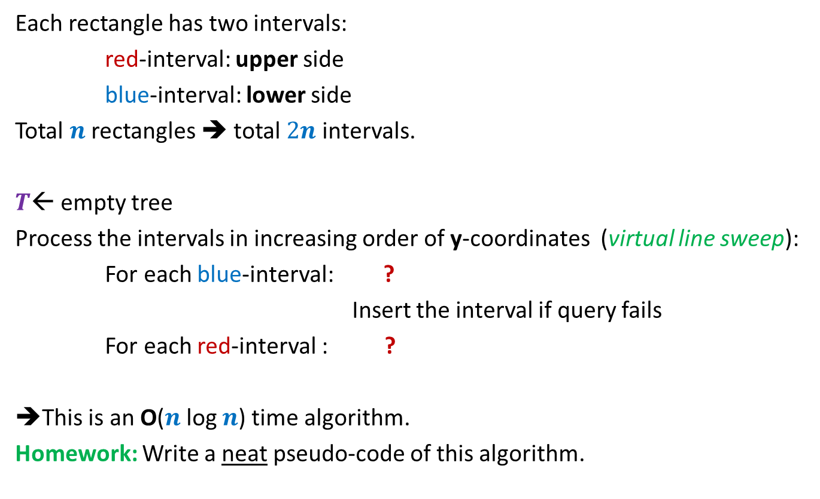

Algorithm
Each rectangle has two intervals:
red-interval: upper side
blue-interval: lower side
Total $n$ rectangles ➔ total $2n$ intervals.
$T$← empty tree
Process the intervals in increasing order of y-coordinates (virtual line sweep):
For each blue-interval: ?
Insert the interval if query fails
For each red-interval : ?
➔This is an O($n$log $n$) time algorithm.
Homework: Write a neat pseudo-code of this algorithm.
query if it intersects any interval in $T$
Delete the corresponding blue interval from $T$

Slide 30
Application 2
Given a set of $n$axis-parallel rectangles,
compute their total area.
It requires some slight modifications to Interval tree.
Try it as an exercise during your winter break!

Slide 31
ProBLEM of NEXT LECTURE
Synchronizing a circuit
with minimum delay enhancement

Slide 32
An Electric Circuit
A complete binary tree
Electric signal
6
5
3
2
4
2
2
1
6
2
1
2
3
2
Delay 11 10 14 10 10 11 10 9

Slide 33
Problem definition
Given:
There is a circuit in the form of a complete binary tree.
Electric signal propagates from root to all leaf nodes.
Each edge has certain delay
The delay in reaching signal to a leaf node =
“sum of delays on all edges on the path from root.”
Objective:
Enhance delay along certain edges so that
The delay on all paths from root to leaf nodes is the same.
Total delay enhancement is minimum.
What is the first step for designing an algorithm ?

Slide 34
Working on an Example

Slide 35
Working on an Example
How to achieve 1st Objective:
Synchronizing all paths from the root?
Spend some time on this portion to see if you can reduce the total delay ?
See you in the next class ☺
+4 is necessary and sufficient as well ☺
What algorithm comes to your mind based on this inference ?
Electric signal
Total delay enhancement: 27
6
5
How much enhancement is needed for this edge ?
3
2
4
2
2
1
6
2
1
2
3
2
+3 +4 +4 +3 +4 +5
+4
Delay 11 10 14 10 10 11 10 9
New Delay 14 14 14 14 14 14 14 14
Is this the minimum delay enhancement ?

